Slide 1

University
Pre-Registration System
Md Abid Uddin
C151085
Kalim amzad Chy.
C151113
Jahedul Kader
C151097
Nazim Uddin
C151094
1

Slide 2
User of System
Student
Teacher
Admin

Slide 3
Role of User
Student
Select course
View Taken courses
Teacher
Upload Result
Admin
Irregular Student Section Assign
Assigning Teacher to a Section
Monitor Student and Teacher

Slide 4
Project at a glance
Semester
Selection
Teacher
Completed Course
Result
Result
Admin
Teacher
Student
Admin
Select
Taken Course
Section
Teacher Assign
Regular
Loaded
Course
Admin
Irregular
Applying
Course
Admin
Section
Admin
Admin
Check Section
Merge Section
Semester
Semester + course

Slide 5
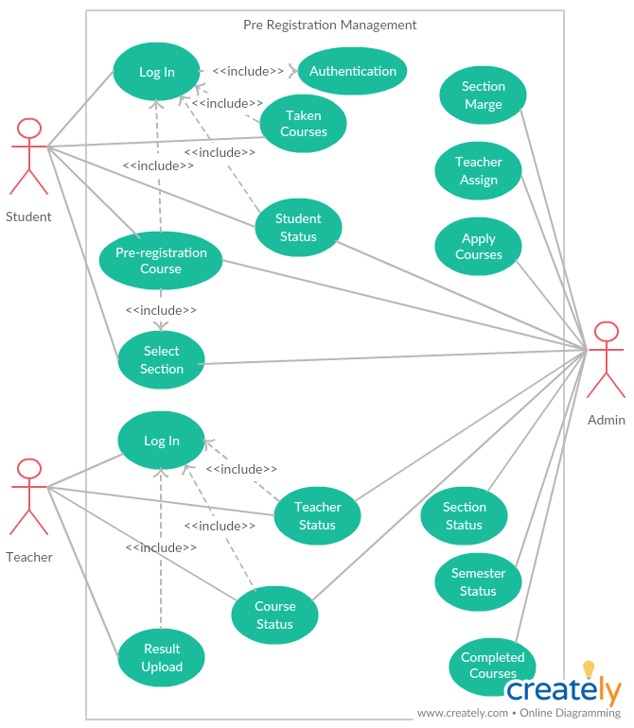
Case Diagram

Slide 6
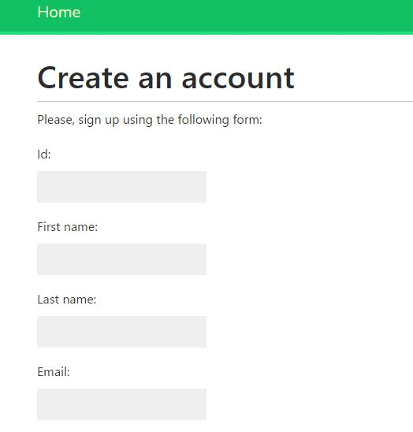
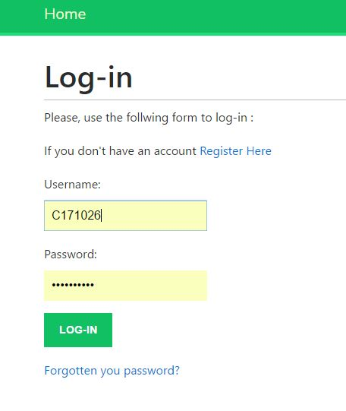
Student

Slide 7
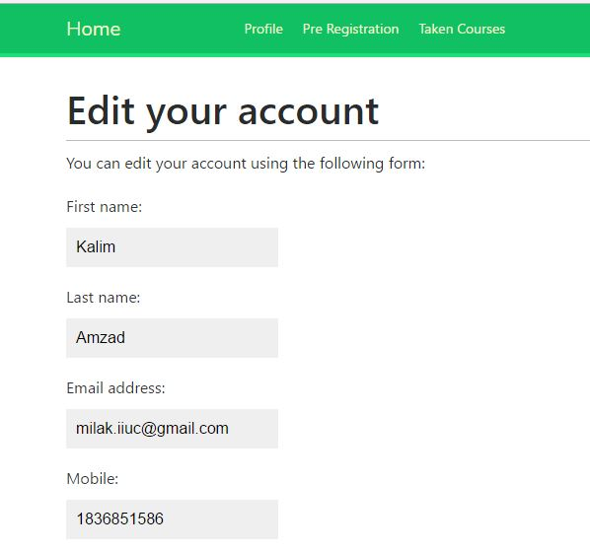
Student Account Edit

Slide 8
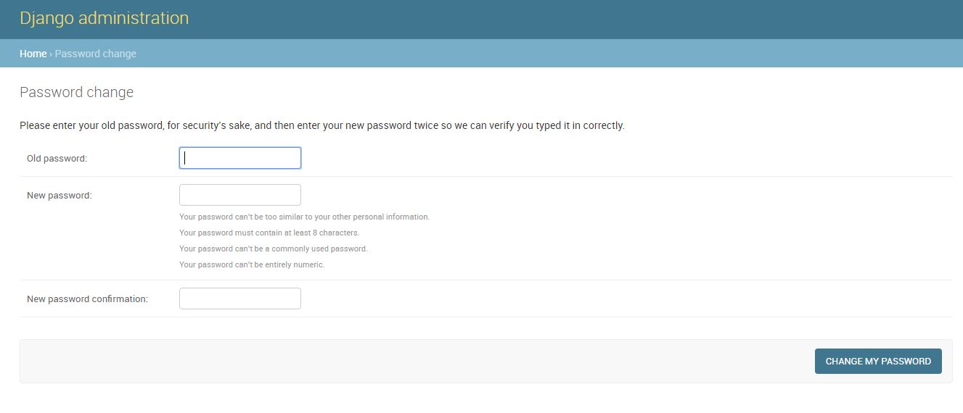
Student Password Change

Slide 9
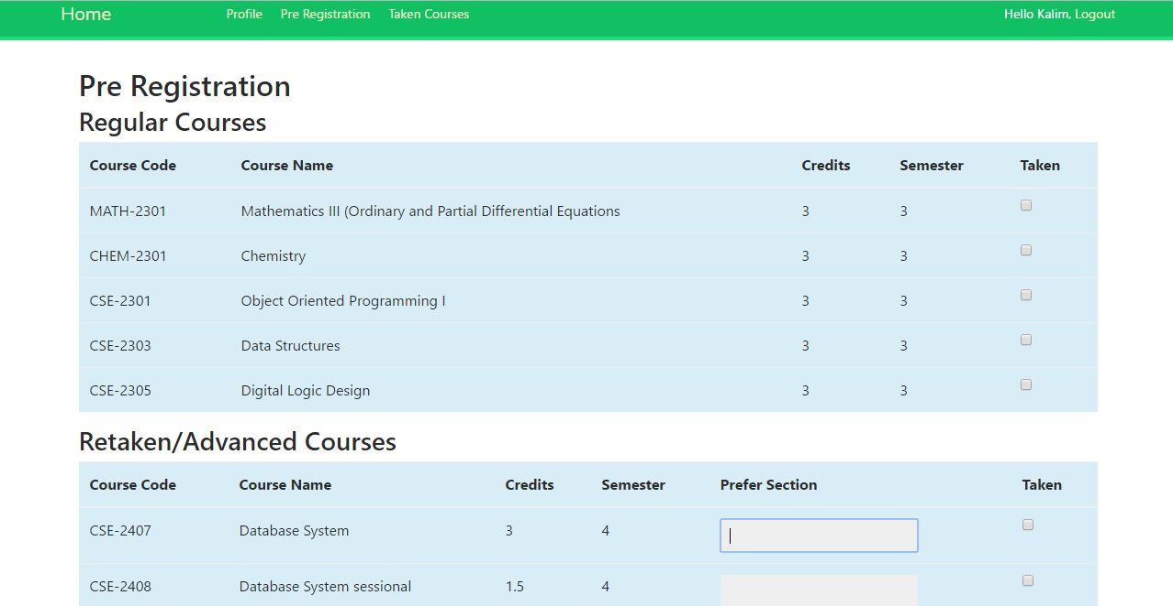
Student Course Selection

Slide 10
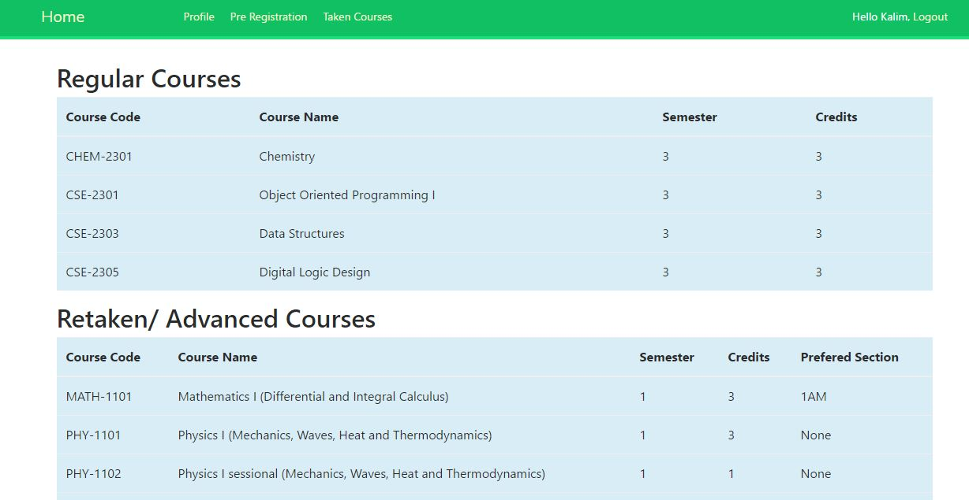
Student Taken Courses

Slide 11
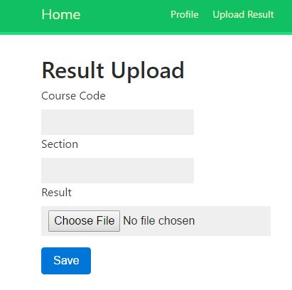
Teacher Result Upload

Slide 12
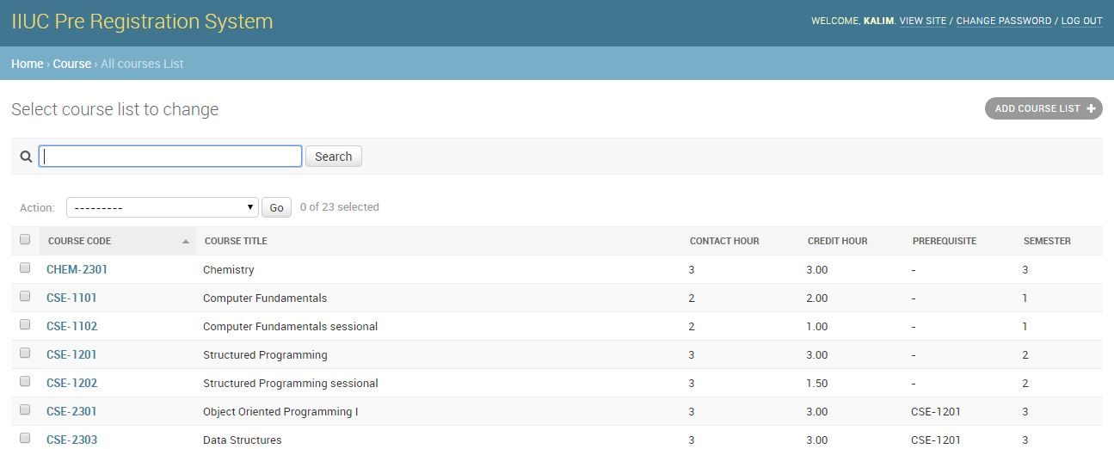
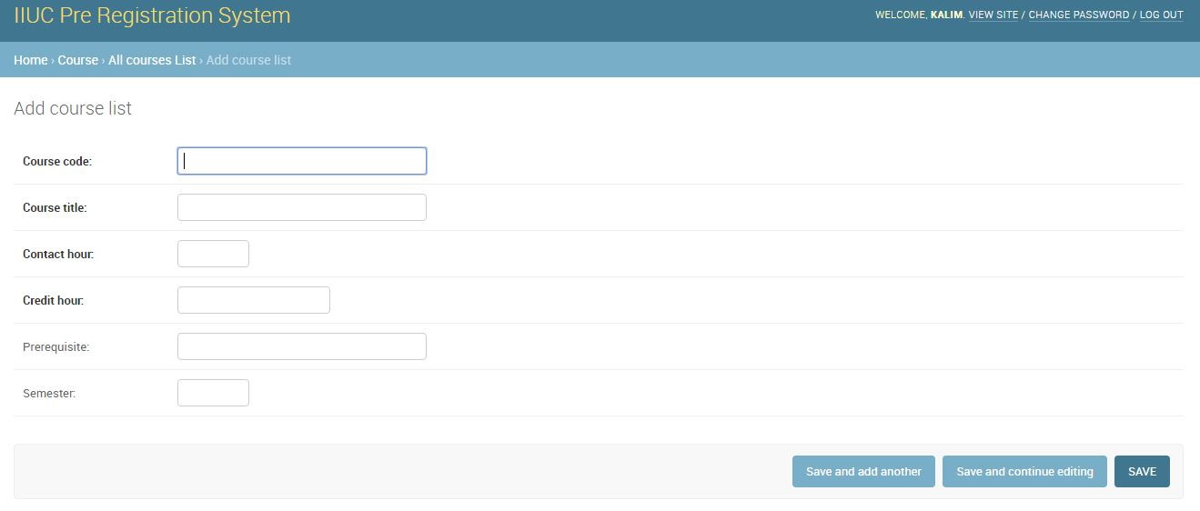
Course List

Slide 13
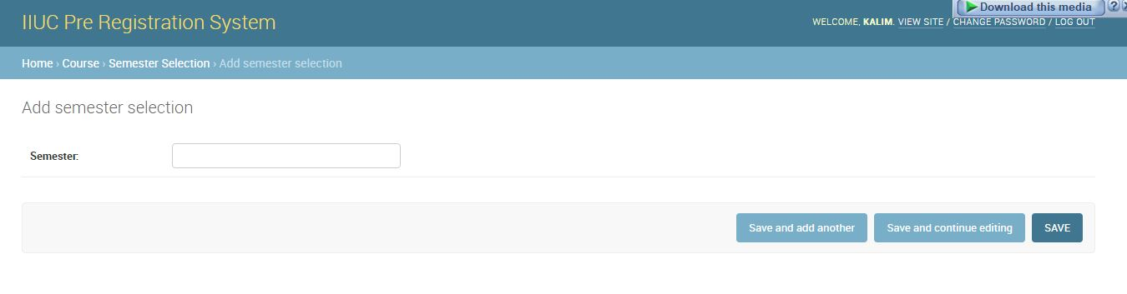
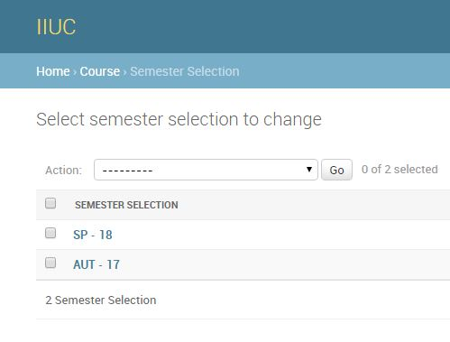
Admin Semester Selection

Slide 14
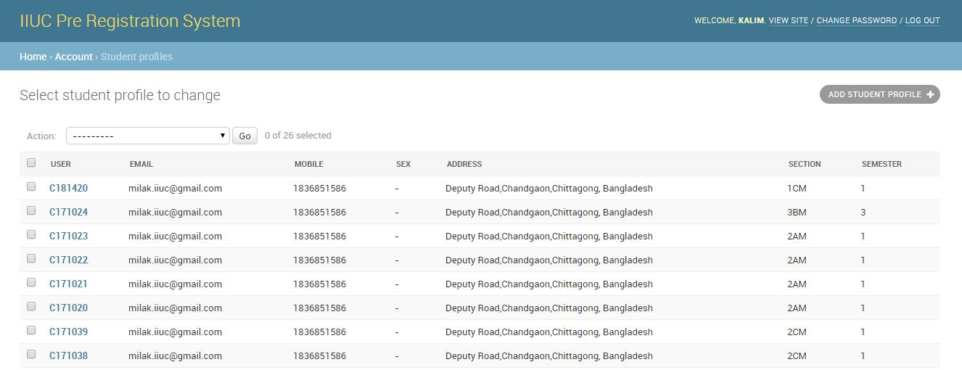
Student Monitoring

Slide 15
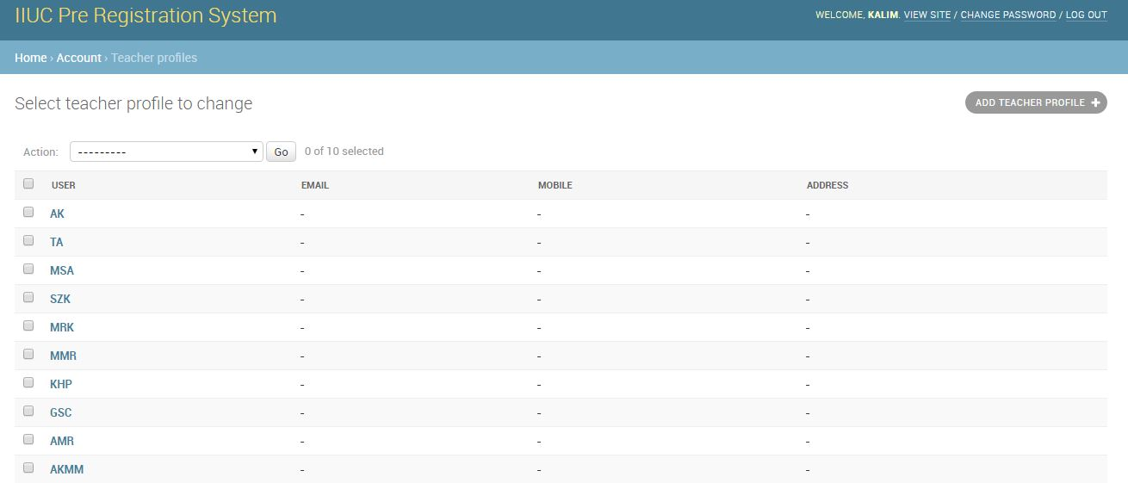
Teacher Monitoring

Slide 16
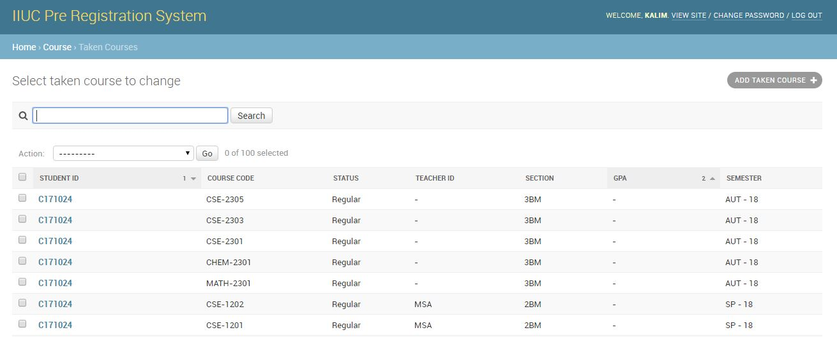
Taken Courses

Slide 17
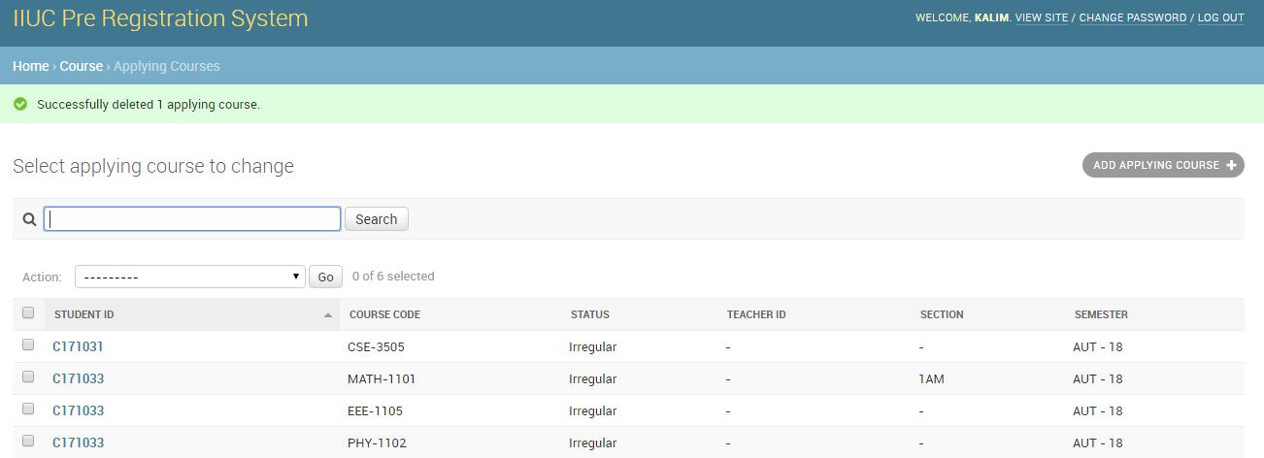
Applying Courses

Slide 18
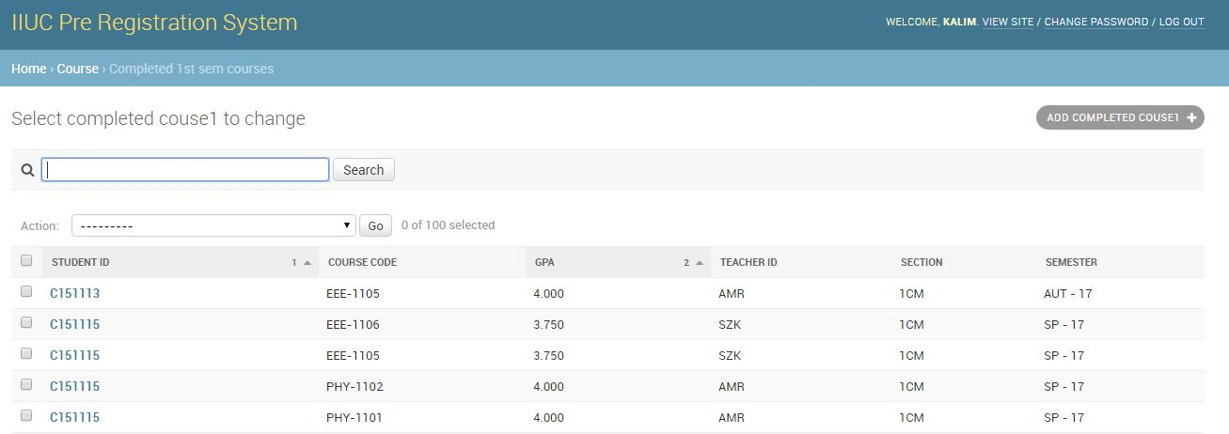
Completed Courses

Slide 19
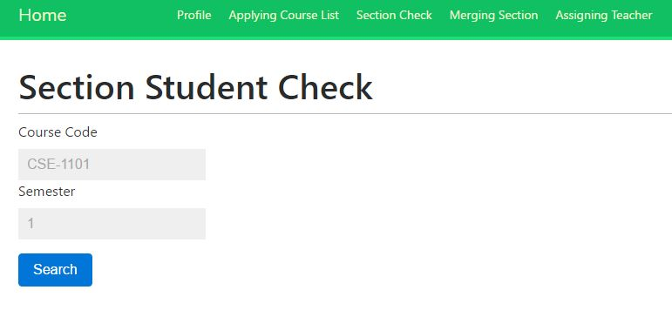
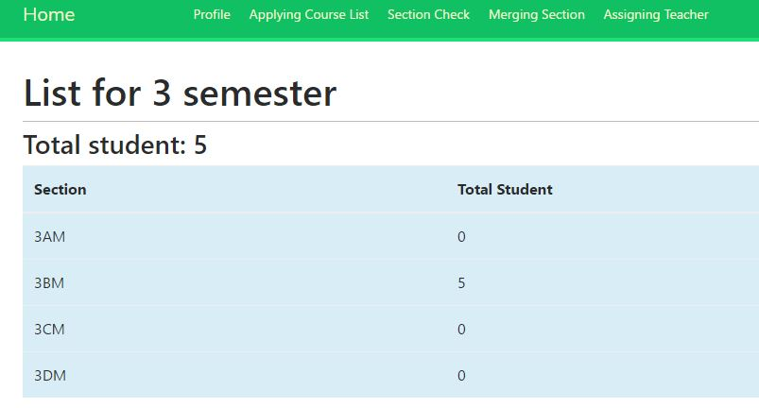
Section Check

Slide 20
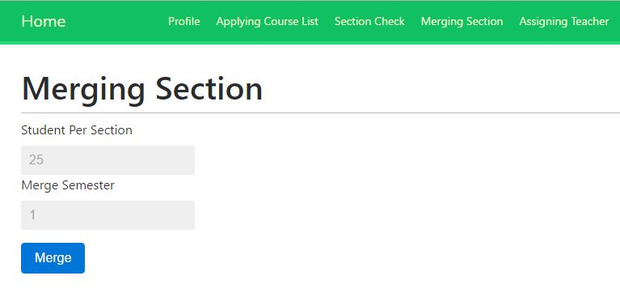
Merge Section

Slide 21
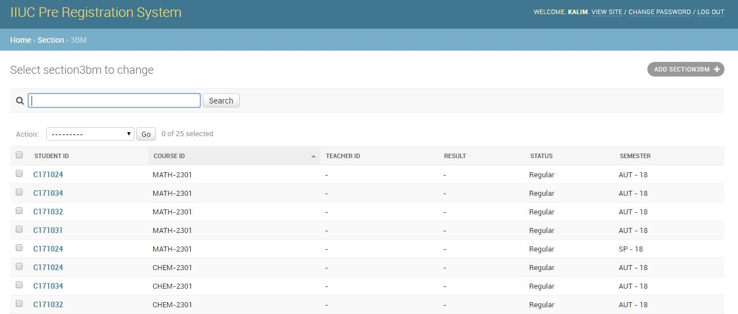
Section

Slide 22
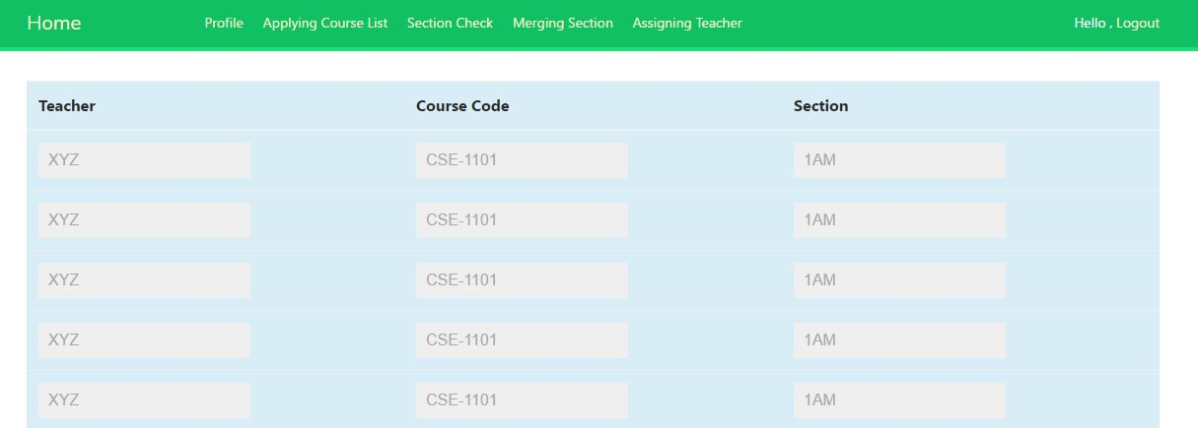
Teacher Assign

Slide 23
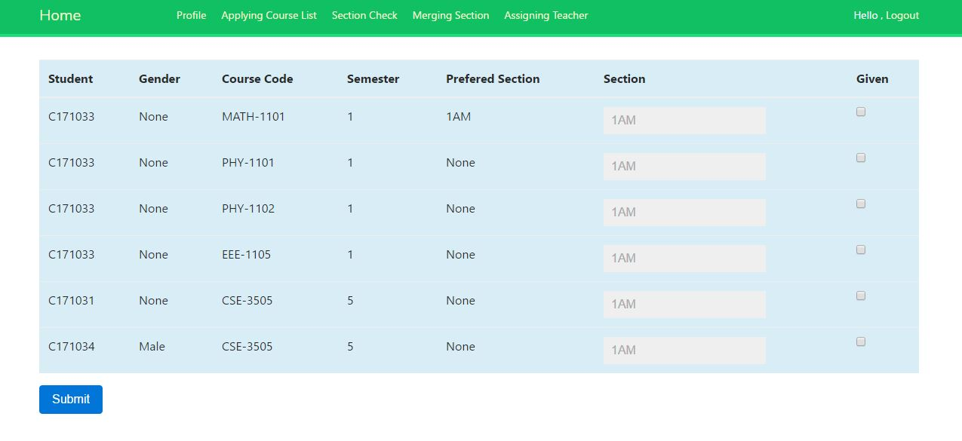
Retake Section Select

Slide 24
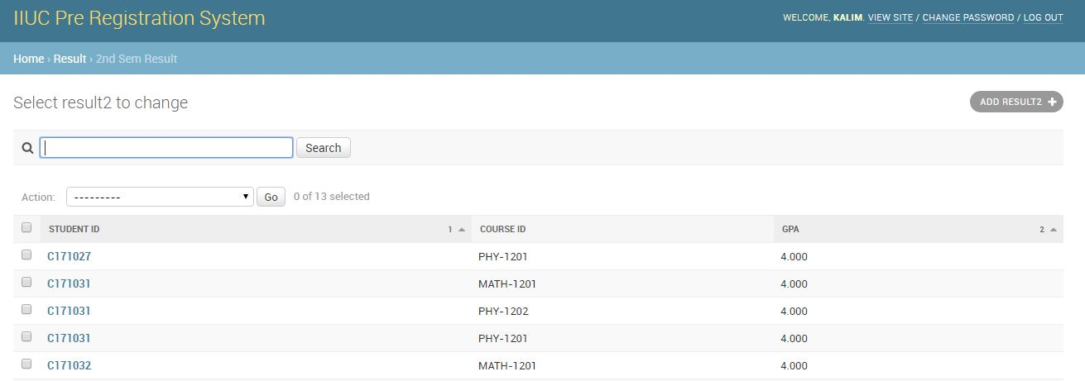
Result

